Slide 1
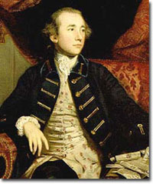
Warren Hastings
Warren Hastings was the first governor-general of British India, from 1773 to 1785.
Lord North's Regulating Act of 1773 placed India under three presidencies, with one governor-general, a position held by Hastings from 1774 to 1784, assisted by a newly created council of five.
He was famously impeached in 1787 for corruption, and acquitted in 1795.

Slide 2
Hastings and East India Company
In 1757 he was made the British Resident (administrative in charge) of Murshidabad
In 1769 appointed as a member of the Madras council
Made as governor of Bengal in 1772.
In 1773, he was appointed the first Governor-General of India.

Slide 3
Warren Hastings's Governorship
New set of Laws was framed for the administering the people of India.
In 1784 Hastings supported the foundation of the Bengal Asiatik Society by the Orientalist Scholar William Jones.
In 1781, Hastings founded Madrasa 'Aliya;
His Domestic Policy
restored order to the province's judicial system
abolished the pension that Lord Clive had paid to the Mughul
Created a new, more efficient procedure for collecting the land revenues, a major source of the company's financial solvency.
The English collectors, being inexperienced and extortionate, were removed and replaced with native officers of proven knowledge and ability

Slide 4
5. Hastings launched military expeditions to defeat the Mahrattas conspiracy that threatened Britain's imperial governance
6. On his own authority, Hastings removed the incompetent governor of Madras and replaced him with the veteran militarist Sir Eyre Coote, who defeated Ali's forces at Porto Novo
Hastings Impeachment
He was impeached for crimes and misdemeanors during his time in India especially for the alleged judicial killing of Maharaja Nandakumar.
Hastings resigned his office in December 1784 and returned to England on 13 June the following year
In 1787 he faced impeachment charges initiated by Edmund Burke

Slide 5
The lengthy trial, beginning in 1788 and lasting until 1795, ended in Hastings's acquittal
He received a doctorate of civil law from Oxford in 1813, and died, a rural recluse, on 22 August 1818.

Slide 6
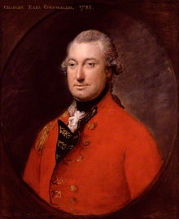
Lord Cornwallis
British governor-general of India (1786–93, 1805)
He brought about a series of legal and administrative reforms in India, notably the Cornwallis Code (1793)

Slide 7
Cornwallis Code:
The Cornwallis Code is a body of legislation enacted in 1793 by the East India Company to improve the governance of its territories in India.
The code contained significant provisions-Governing, Policing and judicial and civil administration
By paying civil servants adequately while forbidding them to engage in private business,
He established a tradition of law-abiding, incorruptible British rule in India.
Cornwallis sought to change the corrupt practice of English officers, first by refusing to engage in such dealing himself, and
second, by securing pay increases for the company's functionaries while denying them their personal trading privileges

Slide 8
Judicial Reforms
In 1790 the company took over the administration of justice from the nawab, and Cornwallis introduced a system of circuit courts with a superior court that met in Calcutta and had the power of review over circuit court decisions.
Judges were drawn from the company's European employees. These reforms also included changes to the penal codes to begin harmonizing the different codes then in use.

Slide 9
Permanent settlement
The Permanent Settlement — also known as the Permanent Settlement of Bengal— was an agreement between the East India Company and Bengali landlords to fix revenues to be raised from land
In 1785 the Court of Directors permitted Cornwallis to implement a settlement with the Zamindars, at first for ten years and to be made permanent if it proved satisfactory. But in 1787 and in 1788 annual settlements were made.
Provision
In 1789 Cornwallis prepared rules for a Decennial settlement
Zamindars were recognised as the permanent owners of the land.
They were given instruction to pay 89% of the annual revenue to the state and were permitted to enjoy 11% of the revenue as their share

Slide 10
The Government became free from the problem of fixation of revenue every year.
The state secured a stable and fixed income from the people.
In case the Zamindars did not pay the revenue, the loss was made good by selling a portion of the land of the Zamindars.
The Zamindars took great interest to increase the production of their lands.
New areas of land were brought under cultivation and the Zamindars also introduced new methods of cultivation like use of manure, rotation of crops etc

Slide 11
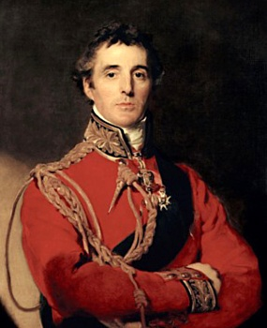
Lord Wellesley
1798 to 1805
Introduction
At the age of thirty-seven he was appointed Governor General on 18 May 1798
His term of office for seven years introduced an important phase in the development of British power in India
His policy allowed him to remove all kinds of French influence from India and to make the British the paramount power of the subcontinent.
He succeeded in his job by implementing wars as well as by peaceful annexations (Subsidiary Alliances)

Slide 12
Subsidiary Alliances
Nature of the alliance
The nature of this alliance, Indian rulers were not allowed to have their independent armed force
2. Instead they were to be protected by the company, but had to pay for the 'subsidiary forces' that the company was supposed to maintain for the purpose of this protection.
3. If the Indian rulers failed to make the payment, then part of their territory was taken away as penalty

Slide 13
The main principles of a subsidiary alliance were:
An Indian ruler entering into a subsidiary alliance with the British had to accept British forces within his territory and also agreed to pay for their maintenance.
The ruler would accept a British Resident in his state.
An Indian ruler who entered into a subsidiary alliance would not enter into any further alliance with any other power, nor would he declare war against any power without the permission of the British.

Slide 14
The ruler would not employ any Europeans other than the British, and if he were already doing so, he would dismiss them
In case of a conflict with any other state, he would agree the resolution decided upon by the British.
7. The ruler would acknowledge the East India Company as the paramount power in India.
8. In return for the ruler accepting its conditions, the Company undertook to protect the state from external dangers and internal disorders.
9. If the Indian rulers failed to make the payments required by the alliance, then part of their territory was to be taken away as a penalty.

Slide 15
Impact of the Policy
Under this doctrine, Indian rulers under British protection surrendered the control of their foreign affairs to the British.
Most disbanded their native armies, instead maintaining British troops within their states to protect them from attack..
3. The Nizam of Hyderabad was the first to enter into such an alliance.
Tipu Sultan of Mysore refused to do so, but after the British victory in the Fourth Anglo-Mysore War, Mysore was forced to become a subsidiary state.
The Nawab of Awadh was the next to accept the Subsidiary Alliance, in 1801.
After the Third Anglo-Maratha War, the Maratha ruler Baji Rao II also accepted a subsidiary alliance.

Slide 16
Timeline of British-Indian subsidiary alliances
1798 - Hyderabad
1799 - Mysore
1799 - Tanjore
1801 - Awadh
1802 - Peshwa
1803 - Scindia
1803 - Gaekwad

